Slide 1
Urology
Clinical Application Specialist Team

Slide 2
Contents
Kidney - Anatomy, function - How to scan - Clinical findings - Study
Bladder
Prostate

Slide 3
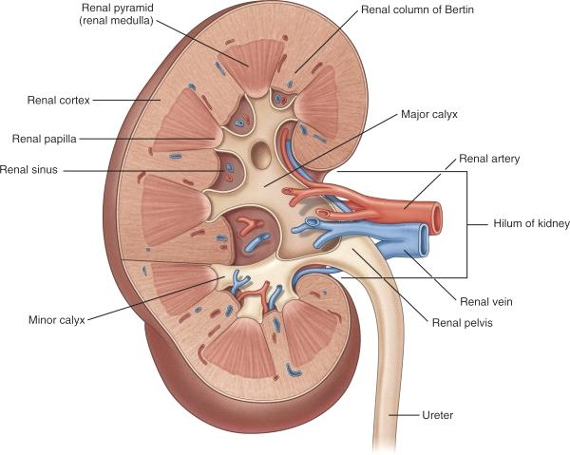
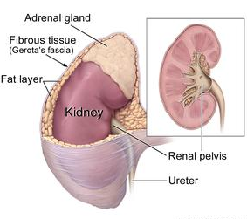
1. Kidney – Anatomy
• Retroperitoneal organ
• Height : 10~14 cm
• Length : 5~6 cm
• Width : 2.5~3 cm
• Weight : 120~190g

Slide 4
1. Kidney – Function
• Excretion
Collects metabolites and wastes to urine
• Homostasis
Maintain constant water content, electrolyte and acidity
• Endocrine
Blood pressure maintenance, hormone production & activation

Slide 5
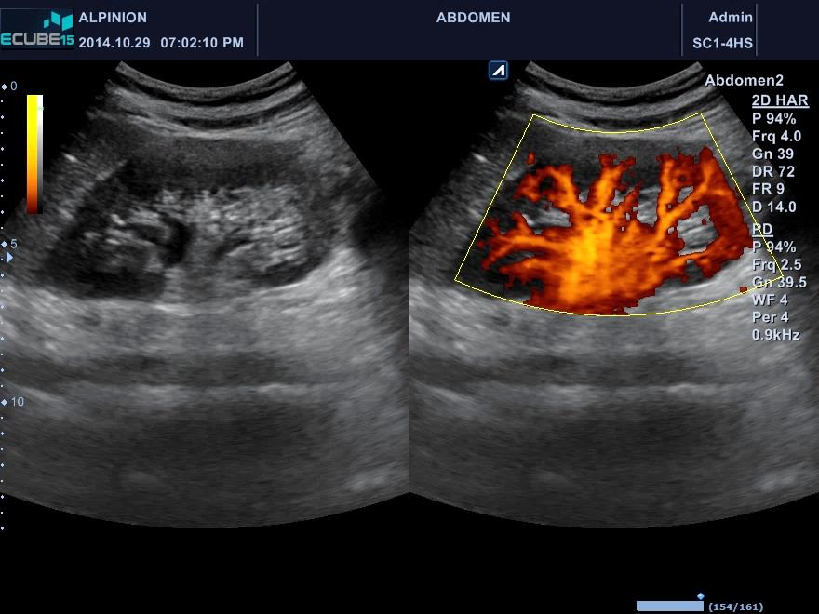
1. Kidney – How to scan
• Patient : Supine
• Probe : Transverse & longitudinal
• Location : Under the liver and spleen
• Characteristic : ①Expressed amount of color
.②Color expression of tree - good at perfusion
P
Cortex
Capsule
Medulla
Renal sinus

Slide 6
1. Kidney – Clinical findings
Congenital | Acquired
Dromedary hump Fetal lobulation Hypertrophied column of Bertin Horseshoe Ectopic | Renal sinus lipomatosis Calculus - (Hydronephrosis) Cyst - (Polycystic) Acute pyelonephritis CRF Carcinoma

Slide 7
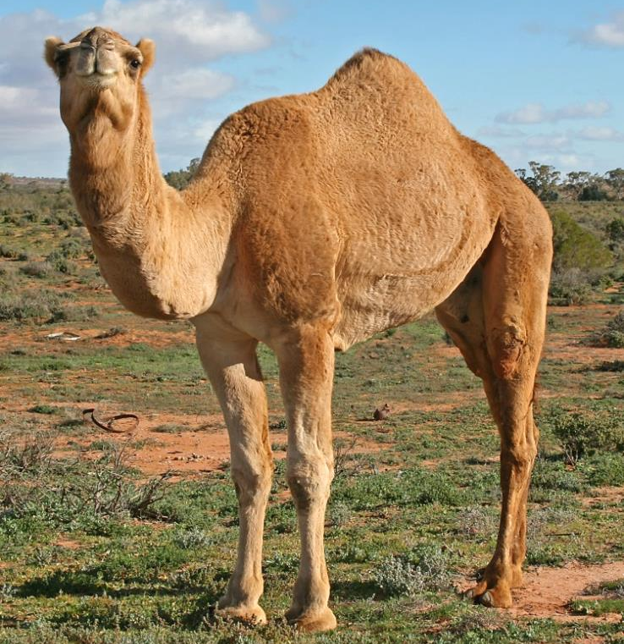
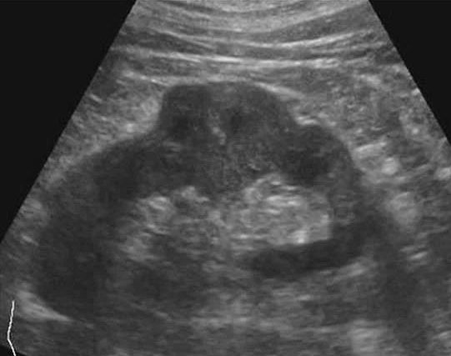
1. Kidney – Clinical findings
Dromedary hump
• Definition : Cortex protruded like camel hump
• Frequency : Fairly common
• Characteristic : Normal function
• Clinical tip : Compare to cortex tissue and 3month FU
Tibia
Femur
Mild
Moderate
Severe

Slide 8
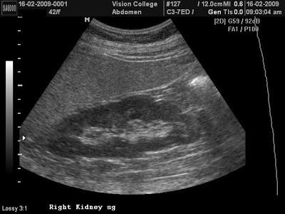
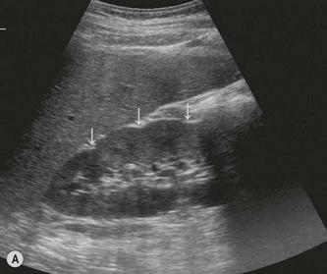
1. Kidney – Clinical findings
Fetal lobulation
• Definition : Signs of kidney segment of birth
• Symptom : Normal function
• Characteristic : Looks like notch
• Clinical tip : Cortex and medullary check
Tibia
Femur

Slide 9
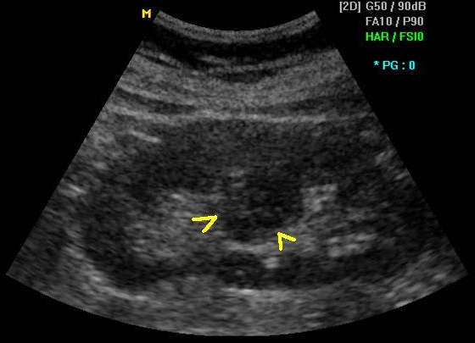
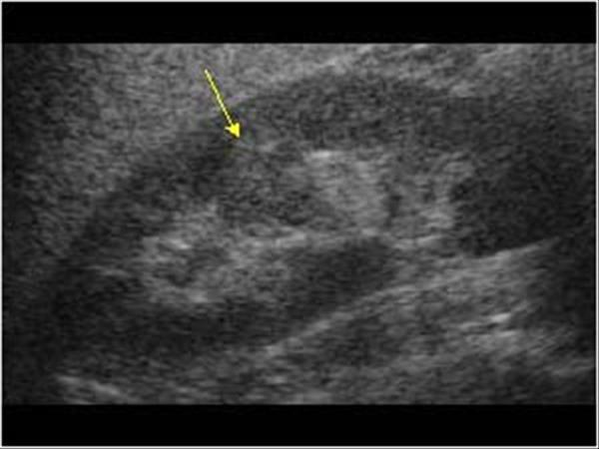
1. Kidney – Clinical findings
Hypertrophied column of Bertin
• Definition : Hyperplasia of cortex to CEC(Central Echo Complex)
• Characteristic : Looks like mass, similar pattern to adjacent cortex
• Clinical tip : Do not show expands of renal pelvis, calyces
Tibia
Femur
Mild
Moderate
Severe

Slide 10
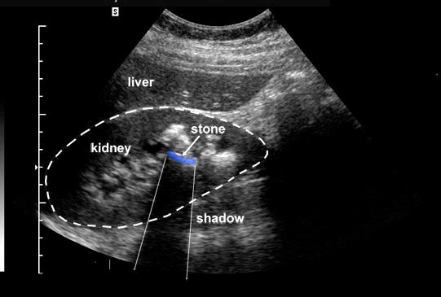
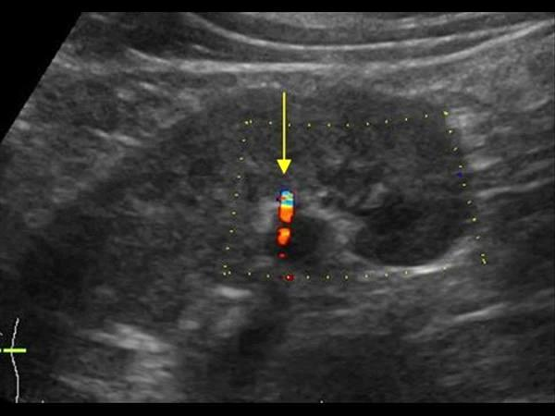
1. Kidney – Clinical findings
Calculus
• Definition : Salt or calcium contained secretions become like stone
• Cause : When Balance is broken due to salts or calcium hyperingestion etc.
• Progress : Abdominal pain, hydronephrosis
• Clinical tip : Posterior shadowing, twinkle artifact
Femur

Slide 11
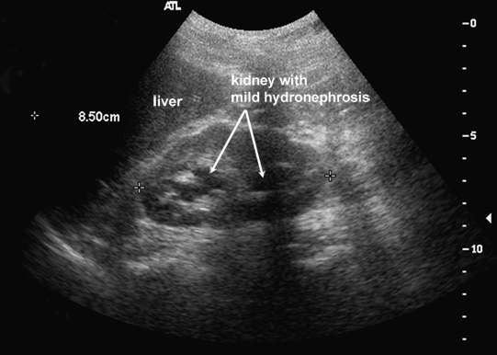
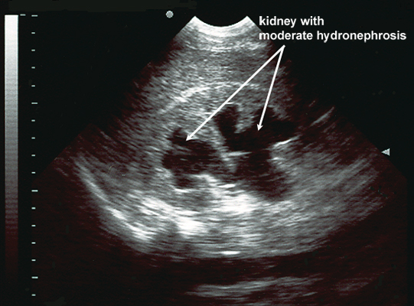
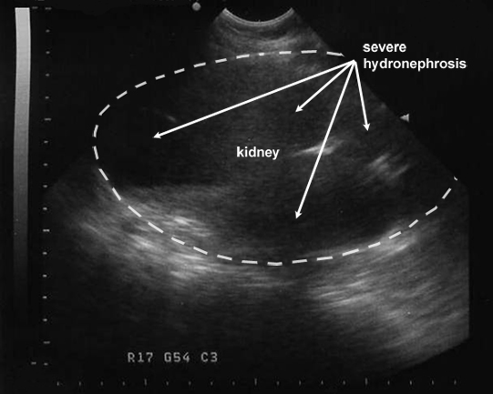
1. Kidney – Clinical findings
Hydronephrosis
• Definition : Renal pelvis and calyces expands due to urine
• Cause : Obstruction of urinary tract, Pregnancy, calculus, bladder reflux,
trauma, Benign prostatic hyperplasia
• Characteristic : ① Mild - renal pelvis expands
..② Moderate - renal pelvis and calyces expands
.. ③Severe - renal pelvis and calyces expands, cortex thin
Tibia
Femur
Mild
Moderate
Severe

Slide 12
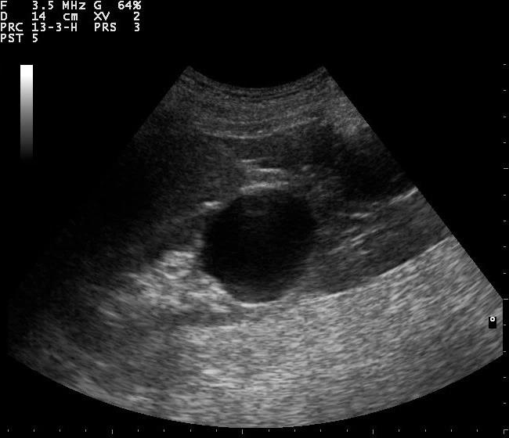
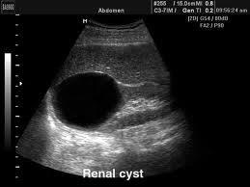
1. Kidney – Clinical findings
Simple cyst
• Definition : Pouch with membrane and contents that are distinct from
surrounding tissue
• Cause : Aging
• Characteristic : Mostly benign
• Clinical tip : Clear boundary and hypoechoic, posterior echo enhancement
Tibia
Mild

Slide 13
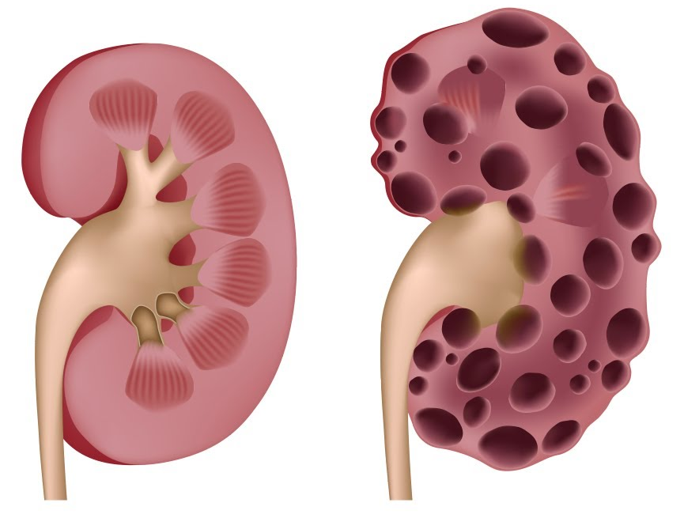
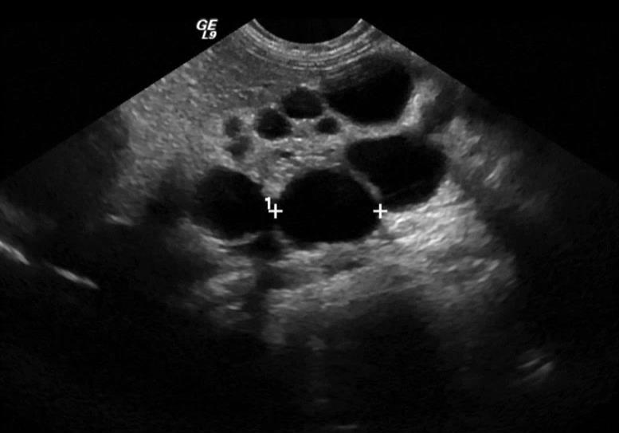
1. Kidney – Clinical findings
Polycystic
• Multiple cyst
①Infantile – Recessive gene, fine cyst,
liver disease
②Adult – Dominant gene, age (over 40Y)
large cyst, complication
Tibia
Femur
Mild
Infantile (Fetal ultrasound)
Adult

Slide 14
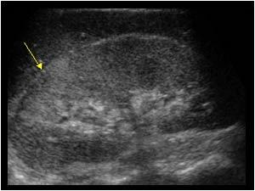
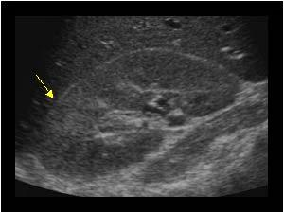
1. Kidney – Clinical findings
Acute pyelonephritis
• Definition : Bacterial growth in kidneys as a kind of urinary tract infection
• Cause : Mostly caused Escherichia coli, female, right kidney
• Symptom : Back pain, fever, hematuria
• Progress : If repeated, develops into chronic pyelonephritis
Tibia
Femur
Mild
Severe

Slide 15
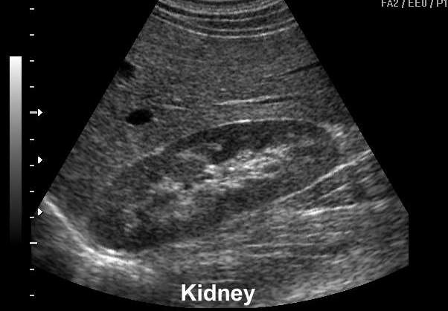
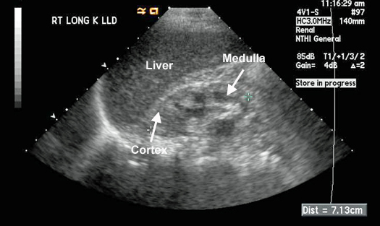
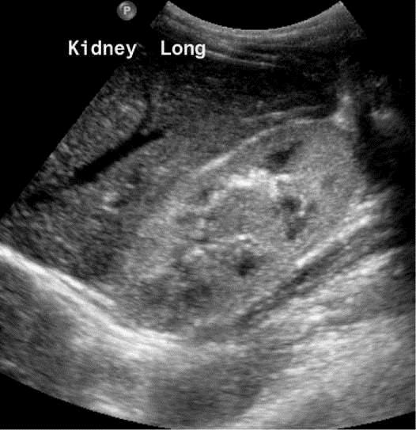
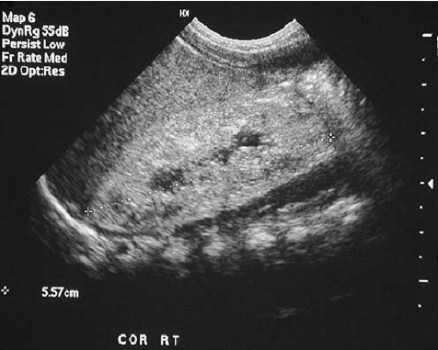
1. Kidney – Clinical findings
CRF (Chronic Renal Failure)
• Definition : Kidney function is very low so waste not excreted
• Cause : Diabetes mellitus, hypertension over 3month, kidney function decrease
• Characteristic : Function is slowly degraded and can not be recovered
• 4 level of echo
- Ⅰ: liver> kidney, Ⅱ: liver=kidney, Ⅲ: liver<kidney, Ⅳ:liver<<kidney
Tibia
Femur
Ⅰ
Ⅱ
Ⅲ
Ⅳ
Severe

Slide 16
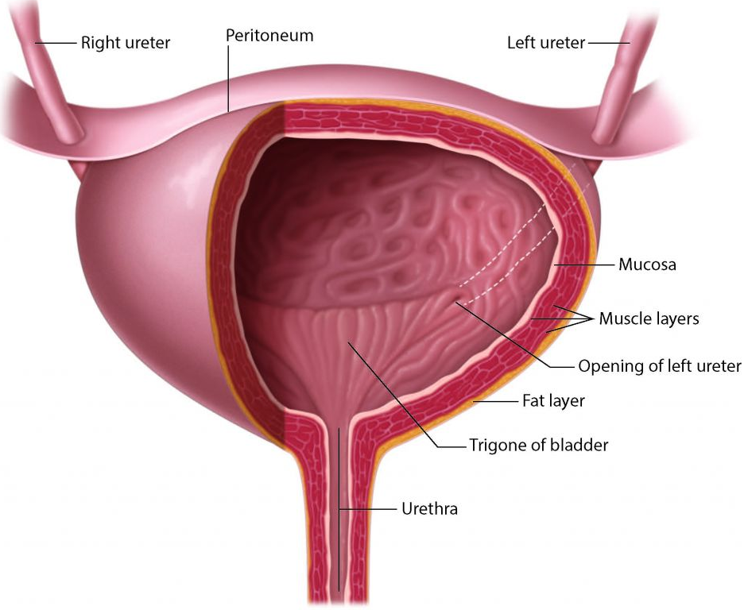
2. Bladder – Anatomy & function
Anatomy
Function
• Storing and discharging urine
• Normal size
- Male : 600ml, Female : 500ml

Slide 17
2. Bladder – How to scan
• Patient : Supine
• Probe : Transverse & longitudinal
• Location : Lower abdomen, upper pubic symphysis
• Preparation : Should full fill the urine
• Characteristic : Filling, post voiding check
Talus
Lateral
malleolus
Talus
neck

Slide 18
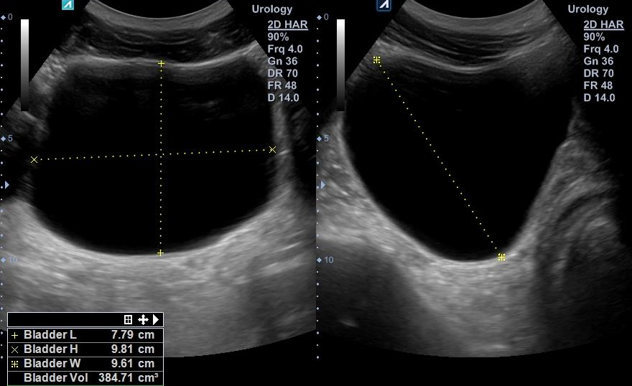
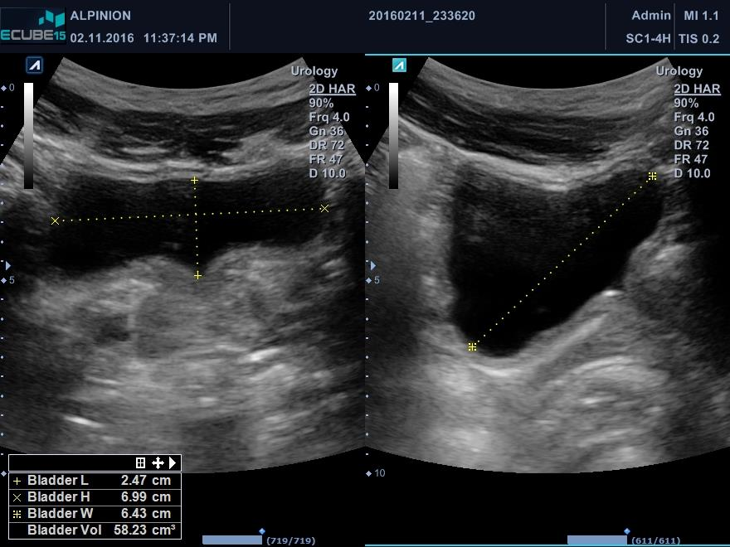
2. Bladder – Measure
Filling & post voiding
• Size : When bladder filled about 300~400ml
• Residual urine : 50~100ml normal
• Normal wall thickness : Filling : 3mm, Voiding : 6mm
Ischial
tuberosity
Sciatic nerve
Hamstring origin
medial
Filling
lateral

Slide 19
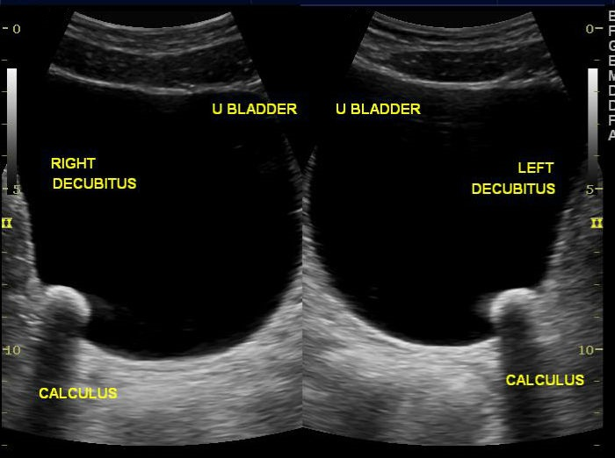
2. Bladder – Clinical findings
Calculus
• Cause : ① Because of cystitis, BPH etc., urine is concentration in bladder
..② Sweat a lot in summer
• Characteristic : ①Primary - Occur in bladder
.②Secondary - Occur in Kidney or ureter
• Clinical tip : Posterior shadowing, moving to patient position
Ischial
tuberosity
Greater
trochanter
medial
lateral

Slide 20
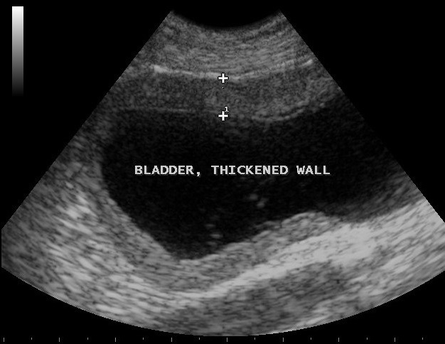
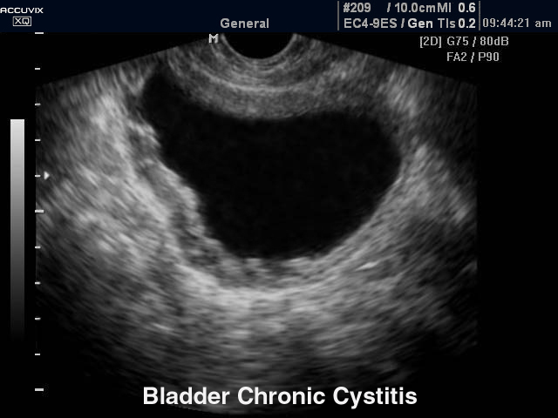
2. Bladder – Clinical findings
Cystitis
• Definition : Symptoms of inflammation in the bladder
• Cause : Bacterial infection - Escherichia coli
• Symptom : Urinary frequency, fever
• Clinical tip : Measure when patient feel urine.
.When filled bladder wall thickness over 4mm
Ischial
tuberosity
medial
lateral

Slide 21
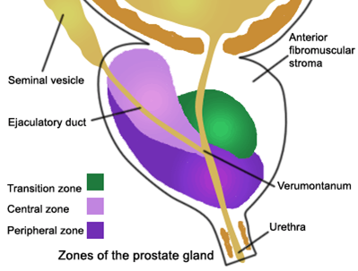
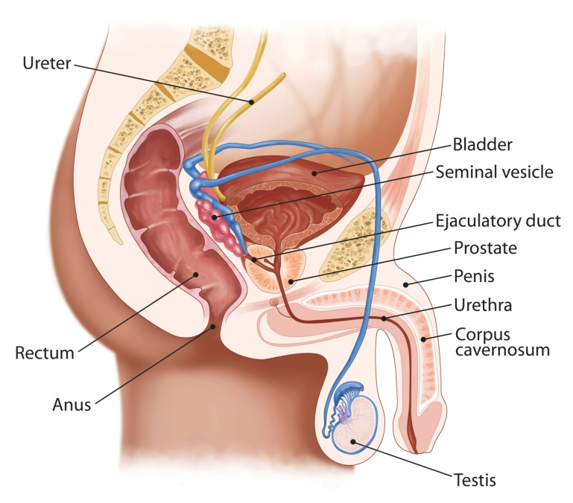
3. Prostate – Anatomy & function
Anatomy
Function
• Size : 20 ~ 30ml
• Peripheral : 70%
Transition : 10%
Central : 20%
• - 30% of sperm
- Important role in survive of sperm
- Feeding sperm, maintain acidity
- Alkaline, neutralize the strong acidity of
the fallopian tubes
- Contain zinc prevents bacteria infection

Slide 22
3. Prostate – How to scan
Compare
 | Transrectal | Transabdominal
Position | Left decubitus | Supine
Scanning field | 6cm | 10cm
Probe | Endo | Convex
Frequency | 3~10MHz | 1~5MHz
Preparation | Voiding bladder, Enema (if necessary) | Filling bladder
Pain | Yes | No

Slide 23
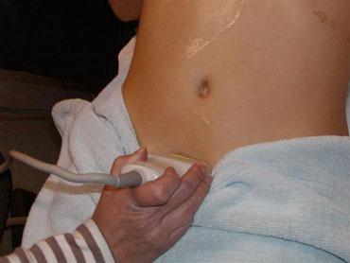
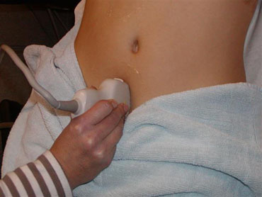
3. Prostate – How to scan
Transabdominal
Prostate
Prostate

Slide 24
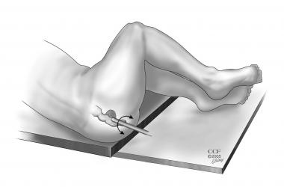
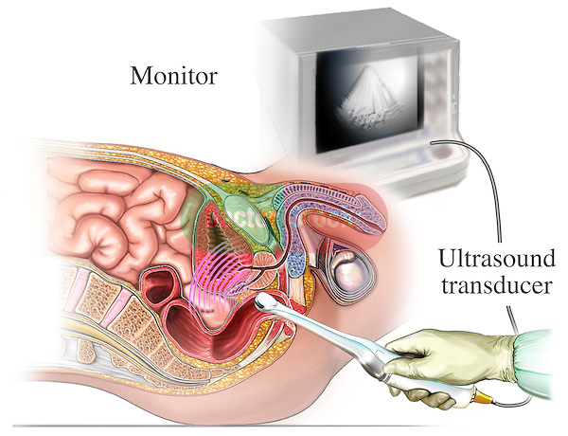
3. Prostate – How to scan
Transrectal
Prostate

Slide 25
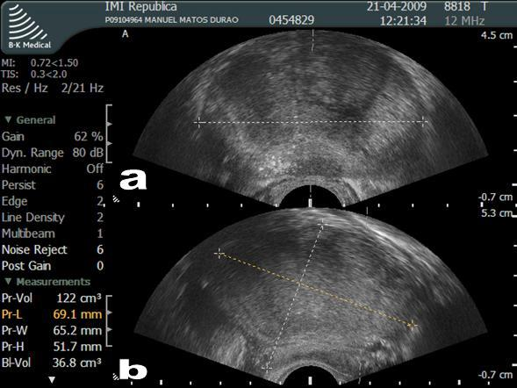
3. Prostate – Meausre
Right method
Anterior facet
Posterior facet
Lateral facet
head
anterior
posterior

Slide 26
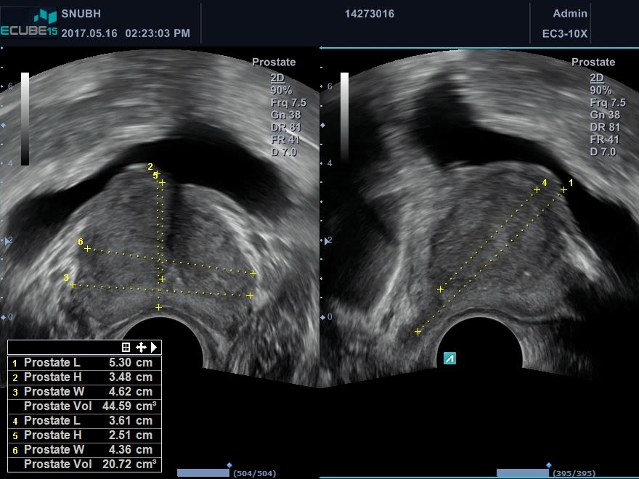
3. Prostate – Meausre
Wrong method
Anterior facet
Posterior facet
Lateral facet
head
anterior
posterior

Slide 27
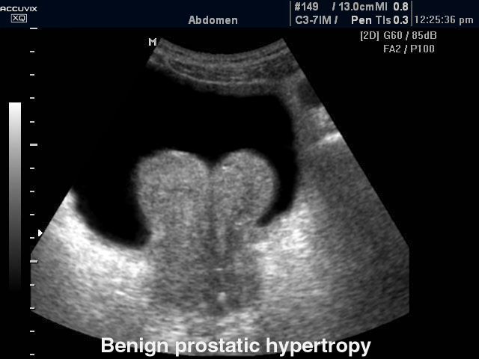
3. Prostate – Clinical findings
BPH (Benign Prostatic Hyperplasia)
• Definition : Prostate enlarged, blocking the passage of urine under the bladder,
causing urinary occlusion and reducing urine flow
• Cause : Aging of scrotum, heredity
• Symptom : Urinary frequency, nocturia
• Clinical tip : Prostate whole volume over about 40ml
Ischial
tuberosity
Sciatic nerve
Greater
trochanter
medial
lateral

Slide 28
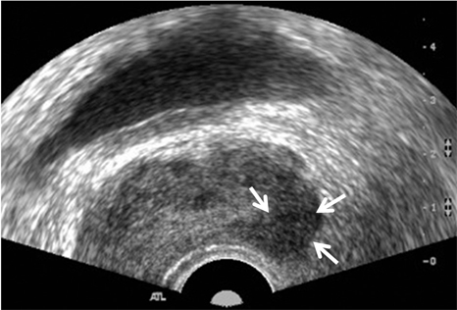
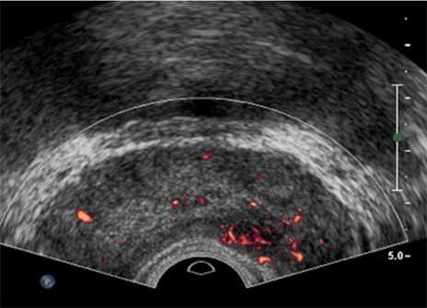
3. Prostate – Clinical findings
Cancer
• Definition : Malignant tumor in prostate
• Cause : Aging, heredity, race
• Symptom : Hematuria, acute urinary retention
• Characteristic : Irregular margin, Heterogeneous, Asymmetric blood flow
distribution
• Percentage : P zone - 70%, T zone - 20% C zone - 10%
Calculus
Ischial
tuberosity
Stone
Sciatic nerve
Hamstring origin
lateral

Slide 29
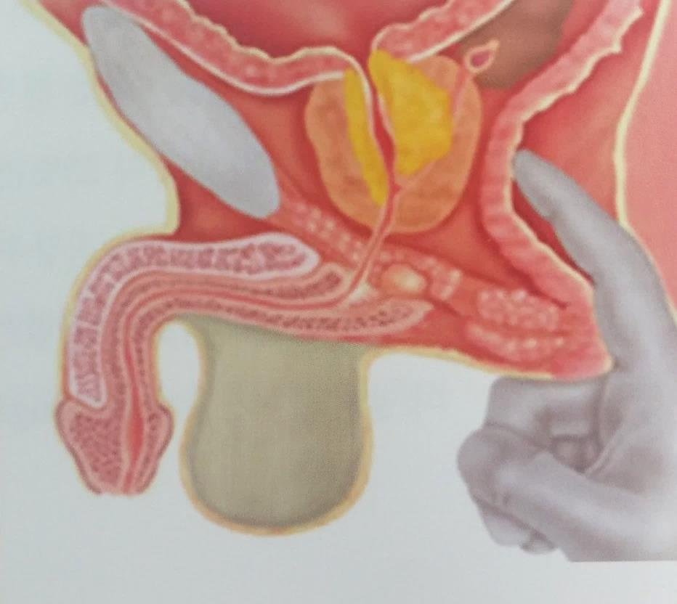
3. Prostate – Study
DRE
PSA
(Direct Rectum Examination)
(Prostate Specific Antigen)
• Protein decomposition enzyme by
made epithelial cell of prostate
• Normal - Below 4ng/ml
Abnormal - Over 10ng/ml
• Cancer suspects increase by more
than 0.75ng/ml in 1 year

Slide 30
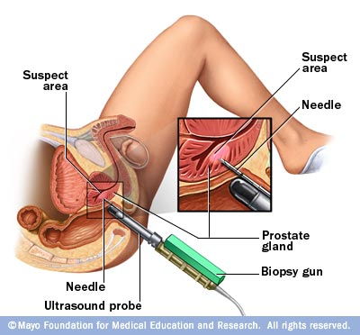
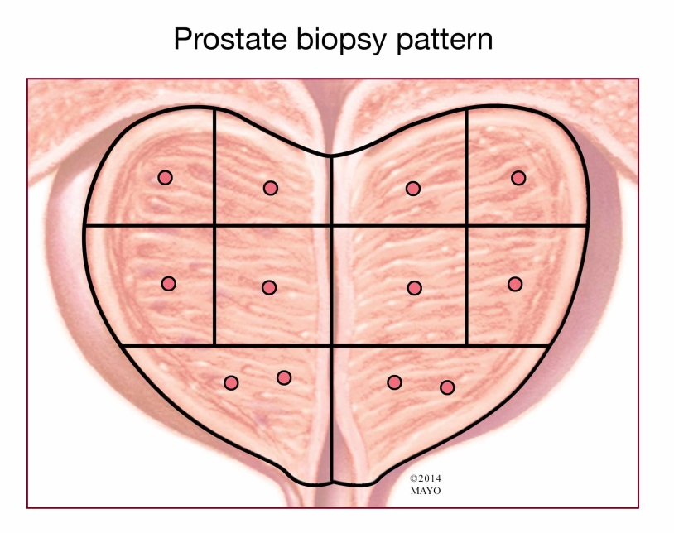
3. Prostate – Study
Biopsy
• When : PSA level over 10ng/ml
• Position : Supine
Ischial
tuberosity
Stone
Sciatic nerve
Hamstring origin
12 core biopsy
medial

Slide 31
THANK YOU

